Slide 1
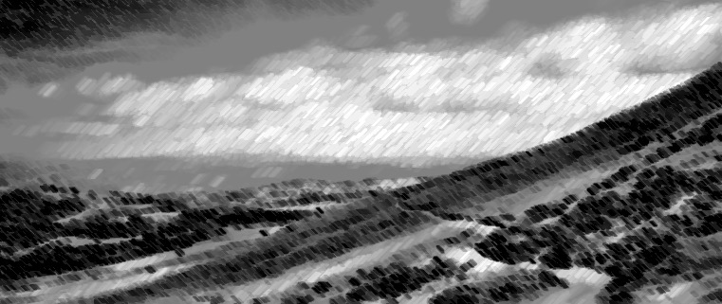
You Are The Way
Chris Jaensch

Slide 2
In our lives we wander in the darkness.
So easily we turn and lose our way.
So often we choose the wrong direction
and we stumble, trip
and fall down every day.

Slide 3
But Your arms are strong.
Your heart is always seeking
to pick us up
and lead us through the haze.
Your love will never, ever, ever leave us.
Your guiding light will never ever fade.

Slide 4
You are the Way
and you’re always there to guide us.
You are the Truth,
your word will never fail.
You are the Life
and death can never hold us.
You are our God,
the Life, the Truth, the Way.

Slide 5
In our lives we’re thrown into distraction
with tempting lies
confusing right and wrong.
The king of lies convinces and seduces.
In our weakness
we forget where we belong.

Slide 6
But Your arms are strong.
Your heart is always seeking
to pick us up
and lead us through the haze.
Your love will never, ever, ever leave us.
Your guiding light will never ever fade.

Slide 7
You are the Way
and you’re always there to guide us.
You are the Truth,
your word will never fail.
You are the Life
and death can never hold us.
You are our God,
the Life, the Truth, the Way.

Slide 8
In this life death is always certain.
It may only take a moment to arrive.
We know we must all face
the final curtain.
Through times of grief
it’s so hard to survive.

Slide 9
But Your arms are strong.
Your heart is always seeking
to pick us up
and lead us through the haze.
Your love will never, ever, ever leave us.
Your guiding light will never ever fade.

Slide 10
You are the Way
and you’re always there to guide us.
You are the Truth,
your word will never fail.
You are the Life
and death can never hold us.
You are our God,
the Life, the Truth, the Way.

Slide 11
You are the Way
and you’re always there to guide us.
You are the Truth,
your word will never fail.
You are the Life
and death can never hold us.
You are our God,
the Life, the Truth, the Way.

